Slide 1

Hands-On With Monte Carlo Simulations
Mohammad Soroush Barhaghi†, Younes Nejahi‡, Loren Schwiebert‡, and Jeffrey Potoff†
† Department of Chemical Engineering & Materials Science, College of Engineering,
‡ Department of Computer Science, College of Engineering, Wayne State University, Detroit, MI,
USA 48202
Notes:
1- MC simulation engine
2- Developed by potoff group & schwibert
3- Developed for running on CPU and GPU
4- CPU system size < 10,000
5- GPU system size > 10,000

Slide 2
Tutorial files
On GitHub
Git clone https://github.com/ GOMC-WSU /Workshop.git
Website https://github.com/GOMC-WSU/Workshop
To run example: change the directory to ~/GOMC-Workshop/

Slide 3
Overview
Grand canonical Monte Carlo simulation
Adsorption of Ar and CO₂ in IRMOF-1
System setup for adsorption in porous materials, using automated HTS tools
Extract the simulation results
Canonical Monte Carlo simulation.
Solvation free energy of Ne, Ar, and Kr in cyclohexane
System setup for free energy calculation
Calculate the solvation free energy with TI and FEP estimators

Slide 4
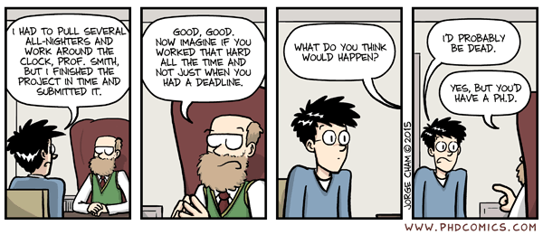
Acknowledgements
Jason Mick, Younes Nejahi, Kamel Rushaidat, Niloofar Torabi, Brock Jackman, Navendu Bhatnagar, Ganesh Kamath, Loren Schwiebert
National Science Foundation CBET-1066661, ACI-1148168, OAC-1642406
NVIDIA, Silicon Mechanics
Grid Computing at WSU

Slide 5
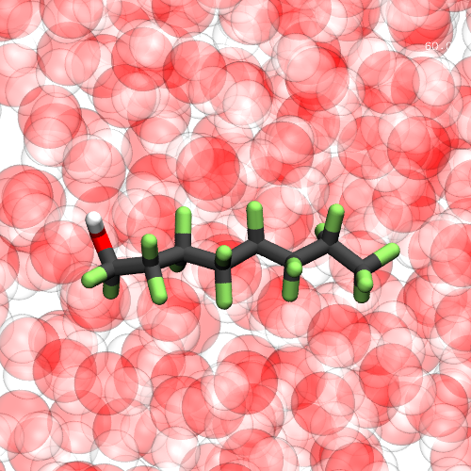
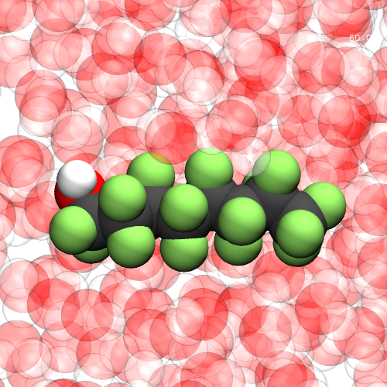

Introduction to GOMC

Slide 6
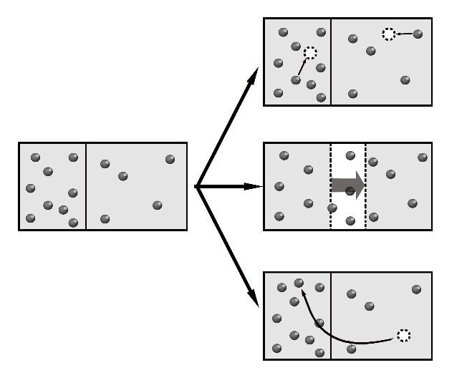
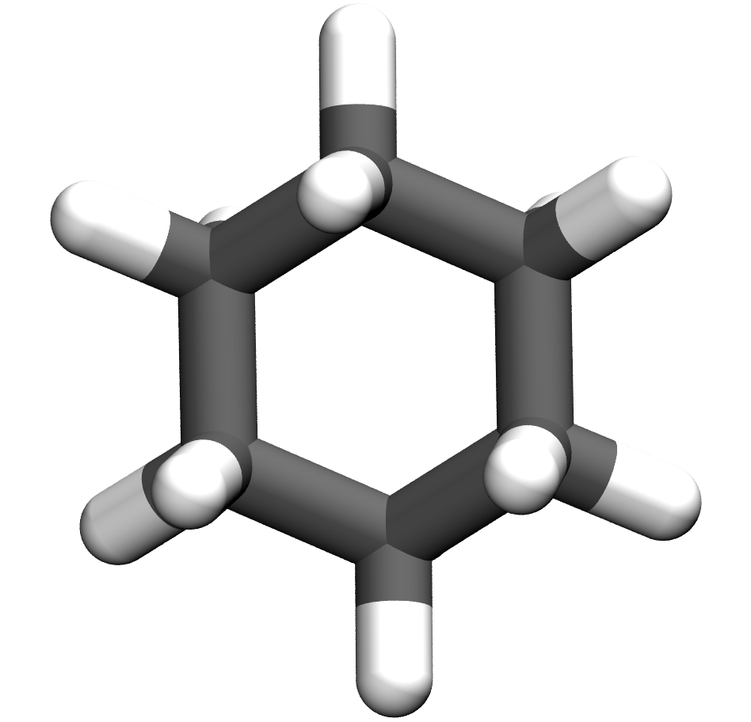
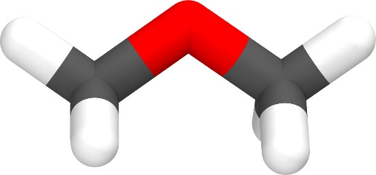
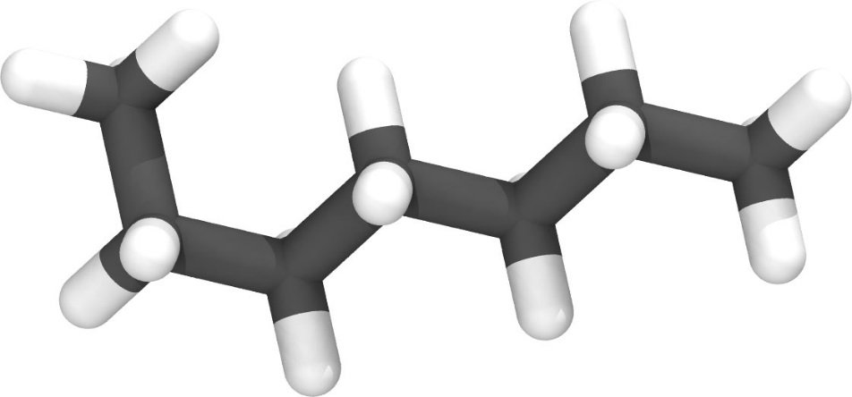
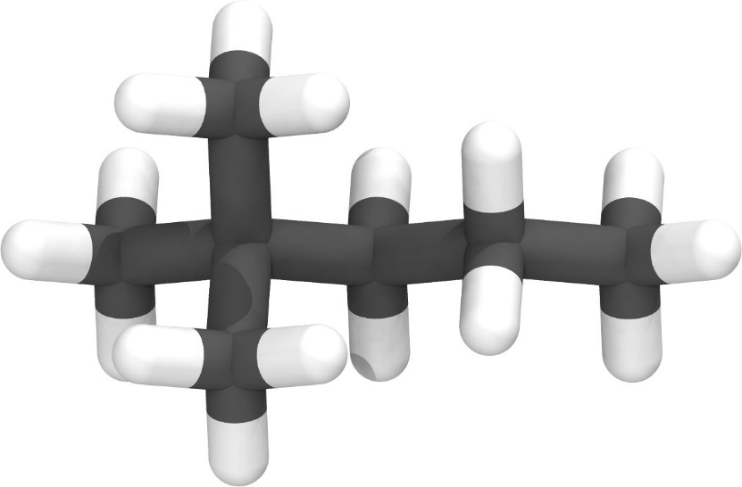

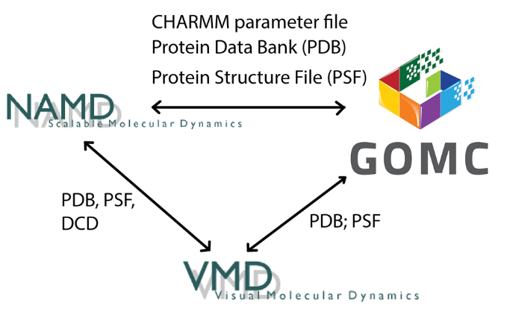
NVT, NPT, GCMC,
and GEMC
Linear, Branched, cyclic, and Polar molecules
Martini
Charmm
OPLS
Mie
Exp-6
Moves Supported:
Displacement
Rotation
Swap; Intra-swap (CD-CBMC)
Regrowth (CD-CBMC)
MEMC (inter/intra)
Multi-particle move
Free energy calculations
Volume (isotropic, anisotropic)
Parallelization
CPU
OpenMP
GPU
OpenMP + GPU

Slide 7
GOMC I/O
PDB
PDB
PSF
PSF
Log
Parameter
Block Averages
Control
GCMC: Histogram

Slide 8
GOMC I/O: Input
PDB
Coordinates of all atoms
PSF
Connectivity between atoms and partial charges.
Maps atom names to atom types
Parameter
Bonded and non-bonded parameters for all atoms,
bonds, angles and dihedrals
Control
Simulation run conditions: box size, temperature
Move ratios, parameter files, etc.

Slide 9
PDB file
X, Y, Z coordinates
ATOM 1 O1 CO2 1 00.000 00.000 00.000 1.00 0.00
ATOM 2 C1 CO2 1 01.160 00.000 00.000 1.00 0.00
ATOM 3 O2 CO2 1 02.320 00.000 00.000 1.00 0.00
Atom ID
Occupancy
Beta
Atom name
residue name
Residue ID
Beta = 0: Displace, Rotate, Intra-swap, Swap, regrowth
Beta = 1: Fix position
Beta = 2: Displace, Rotate, Intra-swap, regrowth

Slide 10
PSF file
3000 !NATOM
1 CO2 1 CO2 O1 O2C -0.350000 15.9994
2 CO2 1 CO2 C1 CO2 0.700000 12.0110
3 CO2 1 CO2 O2 O2C -0.350000 15.9994
Atom ID
Atom type
Segment name
Atom name
Atom charge
Residue ID
Residue name
Atom mass

Slide 11
PSF file
2000 !NBOND: bonds
1 2 2 3 4 5 5 6
7 8 8 9 10 11 11 12
Atom IDs that form a bond
1000 !NTHETA: angles
1 2 3 4 5 6 7 8 9
10 11 12 13 14 15 16 17 18
Atom IDs that form an angle
1000 !NPHI: dihedrals
1 2 3 4 5 6 7 8 9
10 11 12 13 14 15 16 17 18
Atom IDs that form a dihedral

Slide 12
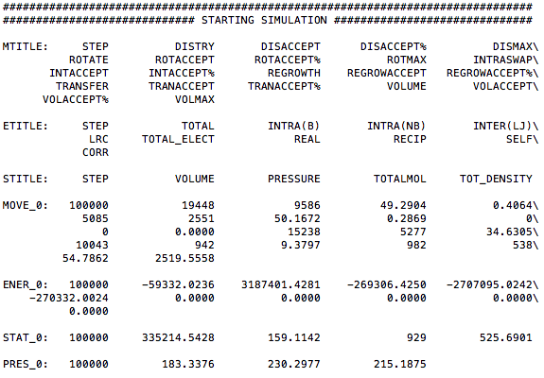
GOMC I/O: LOG Output
80

Slide 13
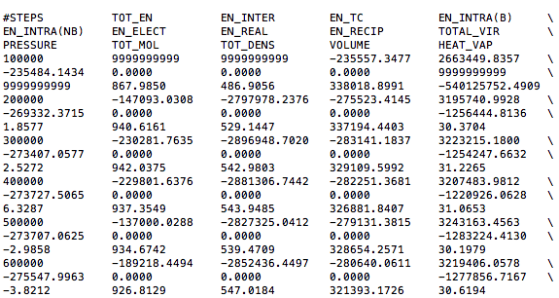
GOMC I/O: BLOCK Output

Slide 14
GOMC I/O: LOG Output
MOVE_<box number>: move statistics
ENER_<box number>: energies
STAT_<box number>: density
Data are stored in columns, making them straightforward to extract with awk.
Quantities are instantaneous values, and are defined with MTITLE, ETITLE and STITLE headers near the beginning of the log file.
Notes:
Talk about output file when Production is running!

Slide 15
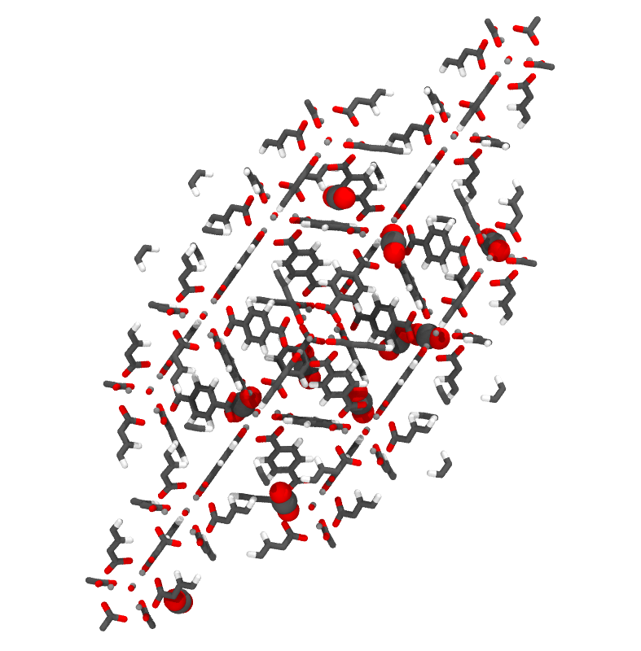
Grand Canonical Monte Carlo Example

Slide 16
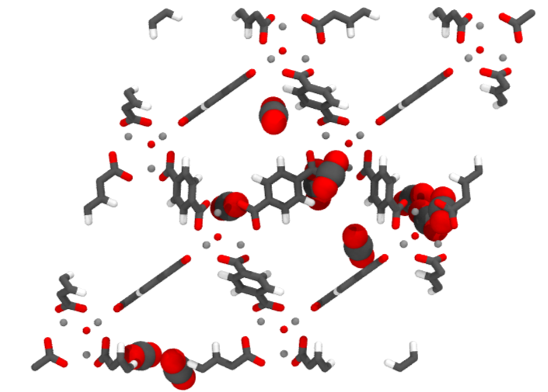
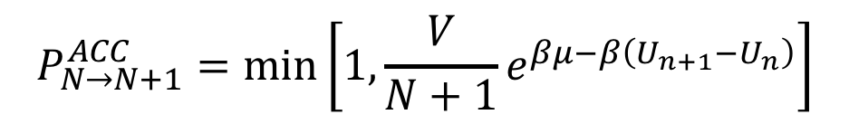
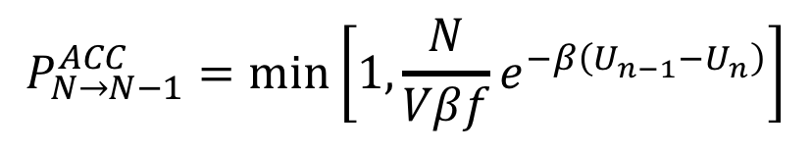
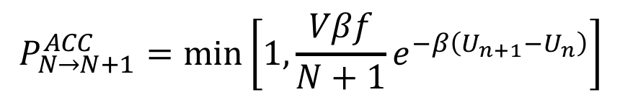
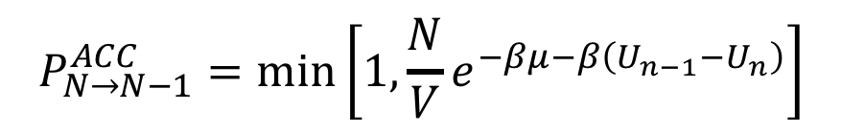
Grand Canonical Monte Carlo
Acceptance criteria for molecule swap in Grand Canonical ensemble Monte Carlo (GCMC).
Chemical Potential (K)
$$P_{N→N+1}^{ACC}=\min\left[1, {\frac{V}{N+1}e}^{βμ−β\left(U_{n+1}−U_{n}\right)}\right]$$
$$P_{N→N−1}^{ACC}=\min\left[1, {\frac{N}{V}e}^{−βμ−β\left(U_{n−1}−U_{n}\right)}\right]$$
Fugacity (bar)
$$P_{N→N+1}^{ACC}=\min\left[1, {\frac{Vβf}{N+1}e}^{−β\left(U_{n+1}−U_{n}\right)}\right]$$
$$P_{N→N−1}^{ACC}=\min\left[1, {\frac{N}{Vβf}e}^{−β\left(U_{n−1}−U_{n}\right)}\right]$$

Slide 17
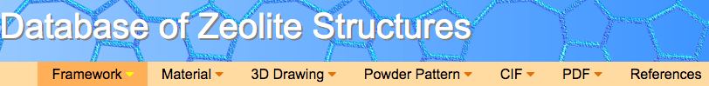

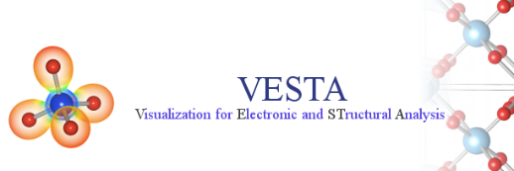
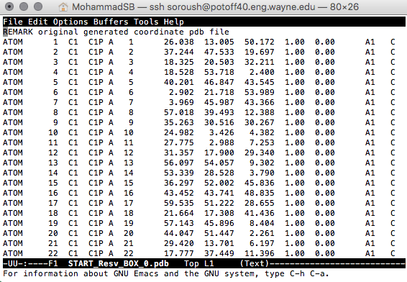
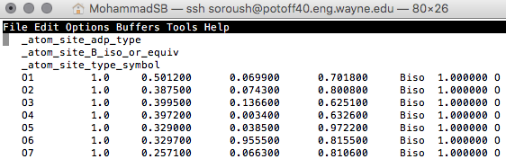
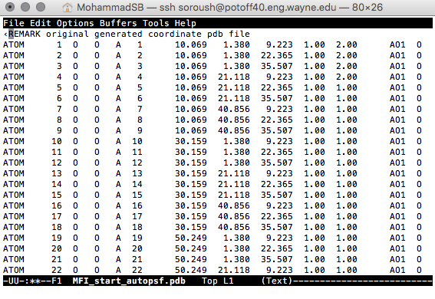
Creating PDB/PSF for adsorbent, manually:
AIChE 2018 workshop: https://github.com/GOMC-WSU/Workshop
Beta = 0: Displace, Rotate, Intra-swap, Swap, regrowth
Beta = 1: Fix position
Beta = 2: Displace, Rotate, Intra-swap, regrowth
Beta Value
Tcl script in VMD
Notes:
Code uses the PDB values in the PDB to determine if a particular molecule should be moved or not.

Slide 18
Creating adsorption simulation file, automatically:
HTS
XML input file
Computation-Ready, Experimental Metal–Organic Frameworks: A Tool To Enable High-Throughput Screening of Nanoporous Crystals, Chem. Mater. 2014, 26, 21, 6185-6192
Notes:
More than 5000 MOFs

Slide 19
Creating adsorption simulation file, automatically:
Extends the unit cell based on cutoff value.
Detects the charge from cif files.
Creates PDB and PSF files for adsorbate and adsorbent.
Creates GOMC configuration file.
Calculates the cell dimensions using cell info. in the cif files.
Creates the simulation files for a single or all MOFs in CoRE MOF database.
Creates the simulation files for multiple temperature and fugacity for each MOF.
Creates Job script for HPC.
HTS
Notes:
Charge are DFT-optimized in ddec

Slide 20
Creating adsorption simulation file, automatically:
System: General information of the system
Model name
Adsorbent information (HTS or single adsorption)
Adsorbate information (Reservoir information)
Simulation: Simulation parameters that are fixed for all runs
MC steps
LJ and coulomb cutoff
Electrostatic calculation parameters
GOMC outputs frequency
Run simulation: Simulation parameters that are flexible for each runs
Temperature
Fugacity
XML input file

Slide 21
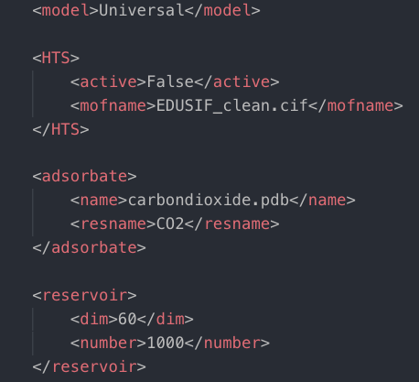
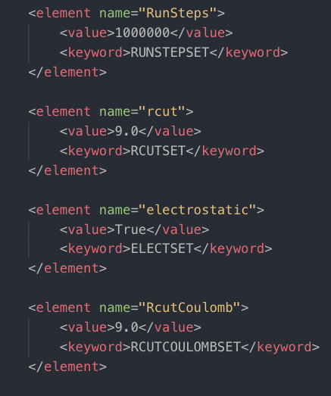
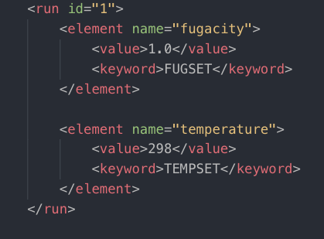
Creating adsorption simulation file, automatically:
System
Simulation
Run simulation
Notes:
Can be easily extended by adding a new field and modifying the template input file

Slide 22
HTS directory setup
run_files
EDUSIF
common
RUN1
RUN2
MOF_base
reservoir_base
...
...

Slide 23
Grand Canonical Monte Carlo Example
Setup simulation files for Ar adsorption in IRMOF-1 (EDUSIF)
Simulation of Ar adsorption in IRMOF-1 at 298 K and 1.0 bar.
Simulation of Ar adsorption in IRMOF-1 at 298 K and 10.0 bar.
Calculate the number of Ar adsorbed.
Setup simulation files for CO₂ adsorption in IRMOF-1 (EDUSIF)
Simulation of CO₂ adsorption in IRMOF-1 at 298 K and 1.0 bar.
Simulation of CO₂ adsorption in IRMOF-1 at 298 K and 10.0 bar.
Calculate the number of CO₂ adsorbed.

Slide 24
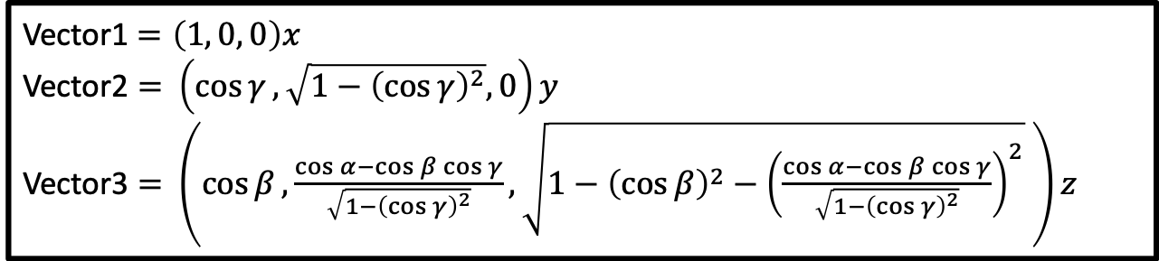
Control file: GCMC
# INPUT PDB, PSF FILES
Coordinates 0 ../common/MOF_base/EDUSIF_BOX_0.pdb
Coordinates 1 ../common/reservoir_base/START_BOX_1.pdb Structure 0 ../common/MOF_base/EDUSIF_BOX_0.psf
Structure 1 ../common/reservoir_base/START_BOX_1.psf
# MOVE FREQUENCY
DisFreq 0.30
RotFreq 0.20
SwapFreq 0.50
# Chemical Potential/Fugacity
Fugacity AR 1.0
Fugacity EDUS 0.0
# BOX DIMENSION #, X, Y, Z
CellBasisVector1 0 36.5320 0.0000 0.0000
CellBasisVector2 0 18.2660 31.6376 0.0000
CellBasisVector3 0 18.2660 10.5459 29.8283
CellBasisVector1 1 60 0.00 0.00
CellBasisVector2 1 0.00 60 0.00
CellBasisVector3 1 0.00 0.00 60
# OutHistSettings
DistName dis
HistName his
RunNumber 1
RunLetter a
SampleFreq 200
Vector1$=\left(1, 0, 0\right)x$
Vector2 $=$ $\left(\cos{γ}, \sqrt{1−{\left(\cos{γ}\right)}^{2}}, 0\right)y$
Vector3 $=$ $\left(\cos{β}, \frac{\cos{α}−\cos{β\cos{γ}}}{\sqrt{1−{\left(\cos{γ}\right)}^{2}}},\sqrt{1−{\left(\cos{β}\right)}^{2}−{\left(\frac{\cos{α}−\cos{β\cos{γ}}}{\sqrt{1−{\left(\cos{γ}\right)}^{2}}}\right)}^{2}} \right)z$

Slide 25
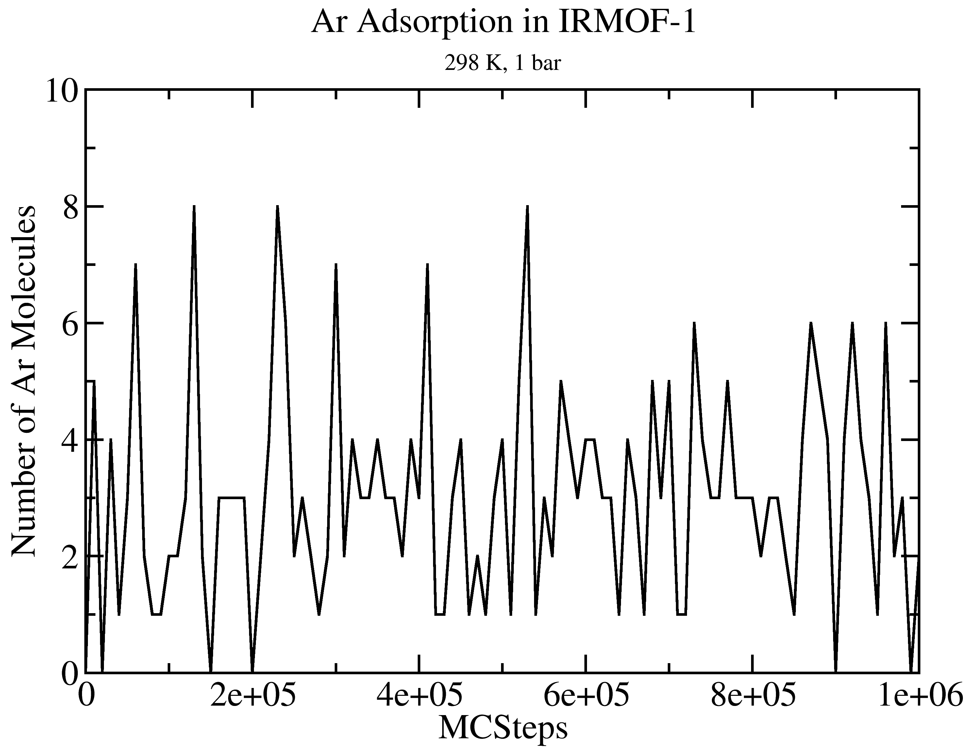
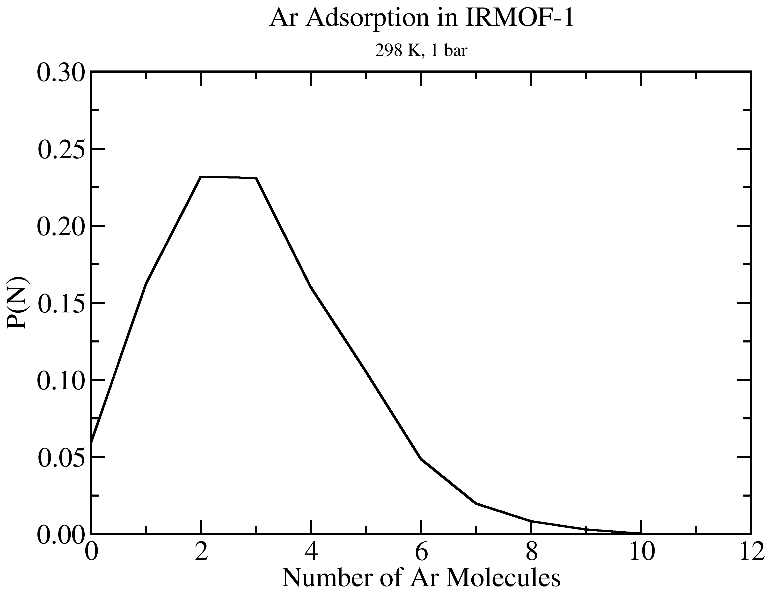
GOMC I/O: GCMC
Extract data using awk
cat output_AR.log | awk '/STAT_0/ {print $2, $3*$5}' > mol_AR_fluct.dat

Slide 26
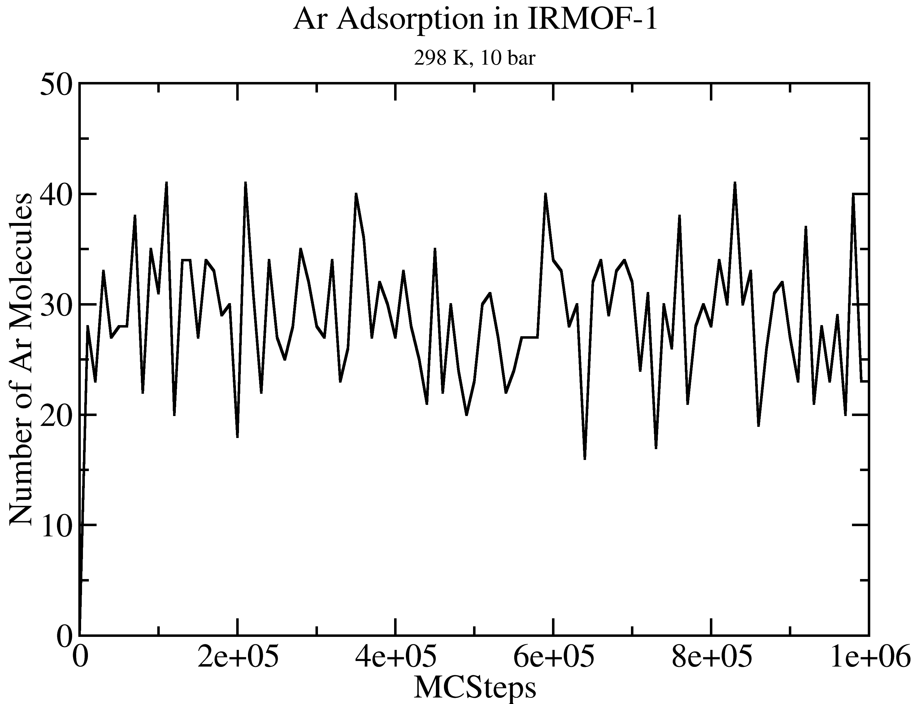
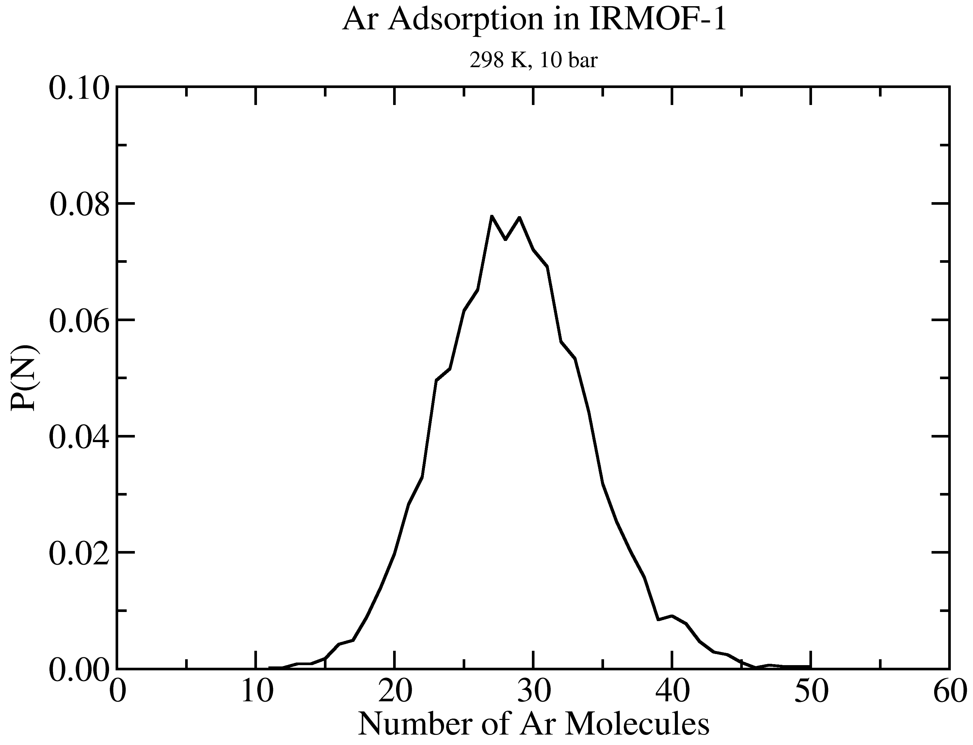
GOMC I/O: GCMC
Extract data using awk
cat output_AR.log | awk '/STAT_0/ {print $2, $3*$5}' > mol_AR_fluct.dat

Slide 27
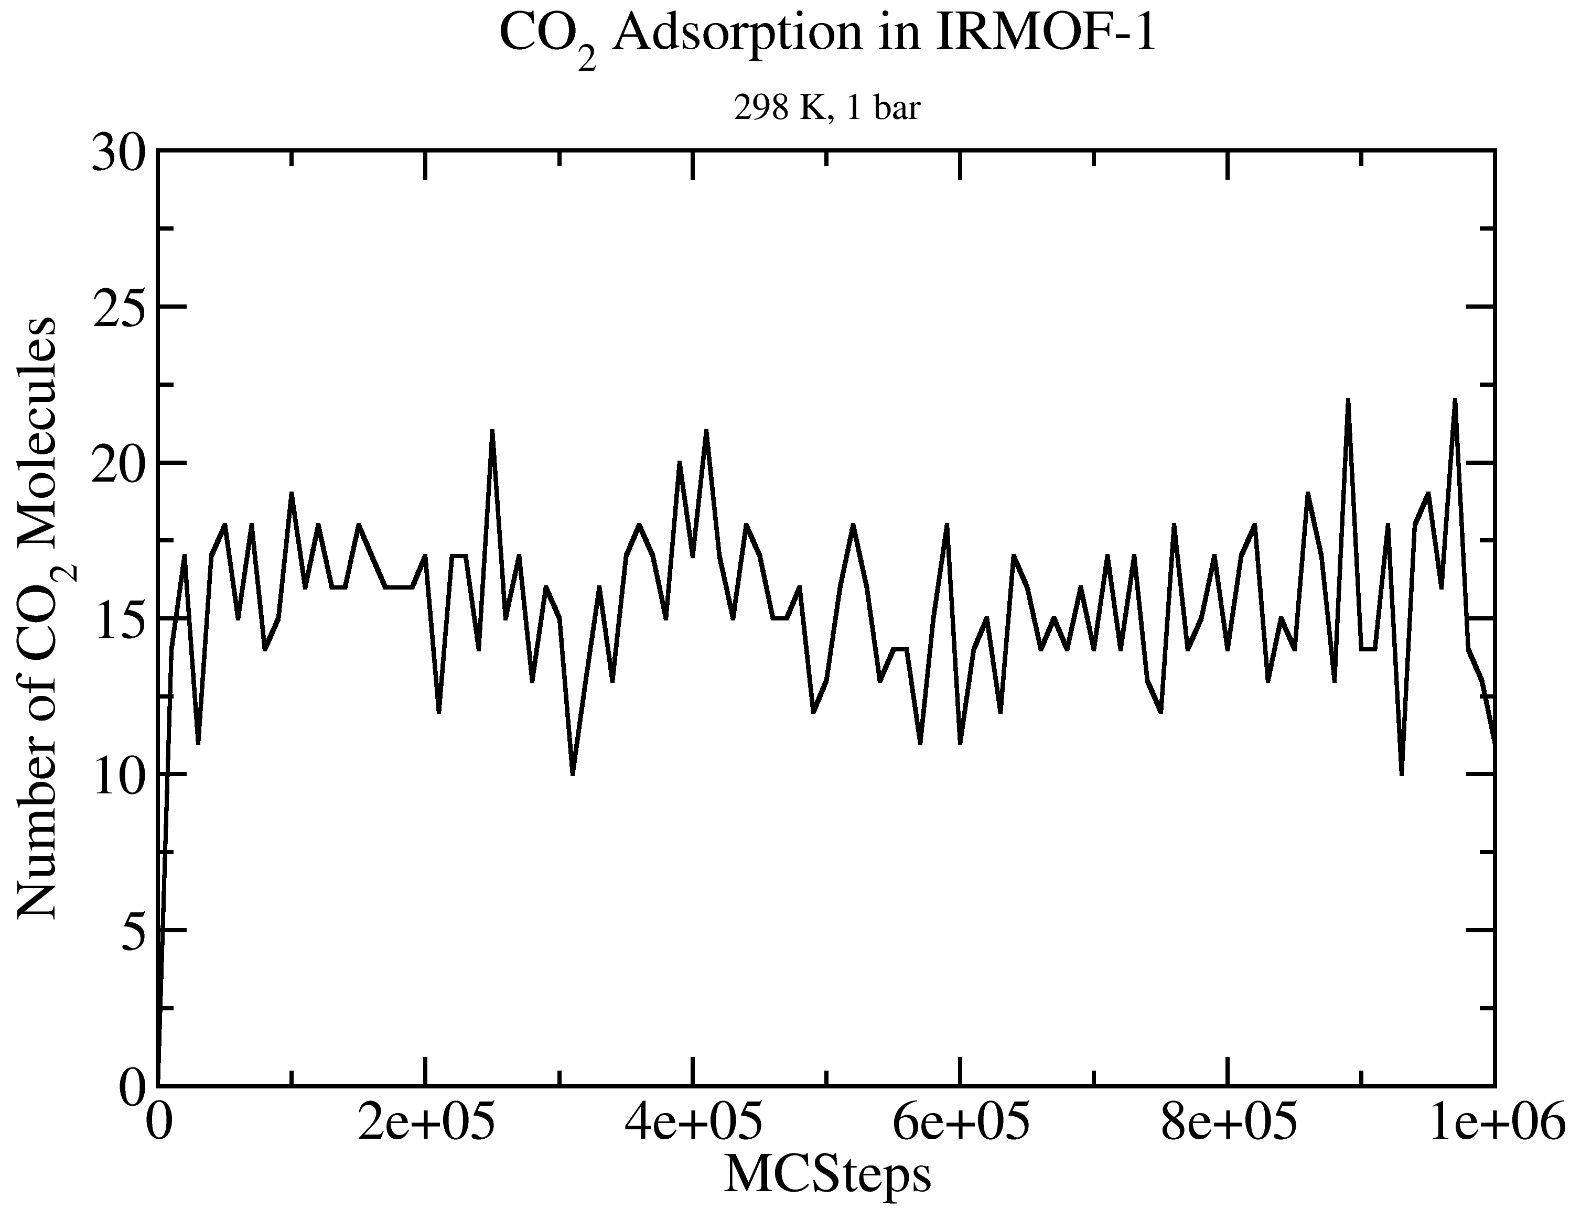
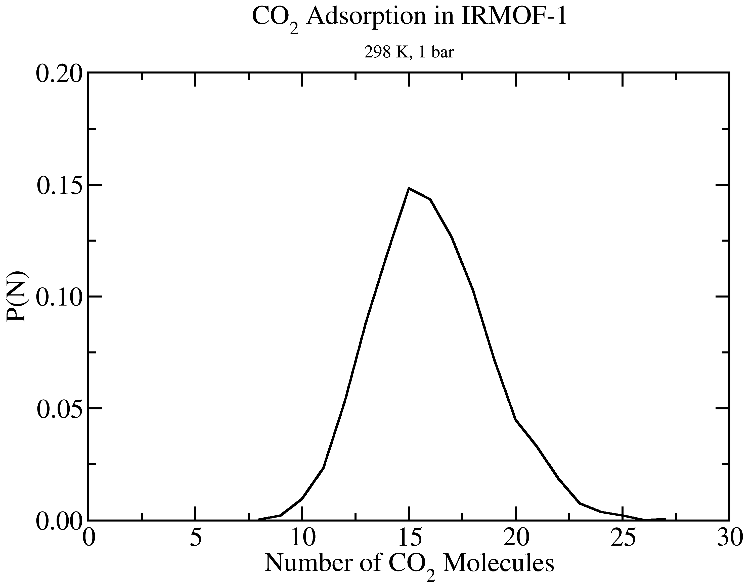
GOMC I/O: GCMC
Extract data using awk
cat output_CO2.log | awk '/STAT_0/ {print $2, $3*$5}' > mol_CO2_fluct.dat

Slide 28
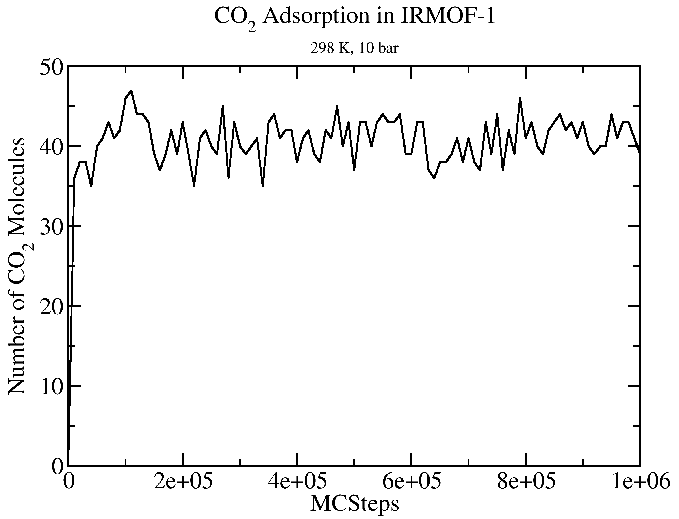
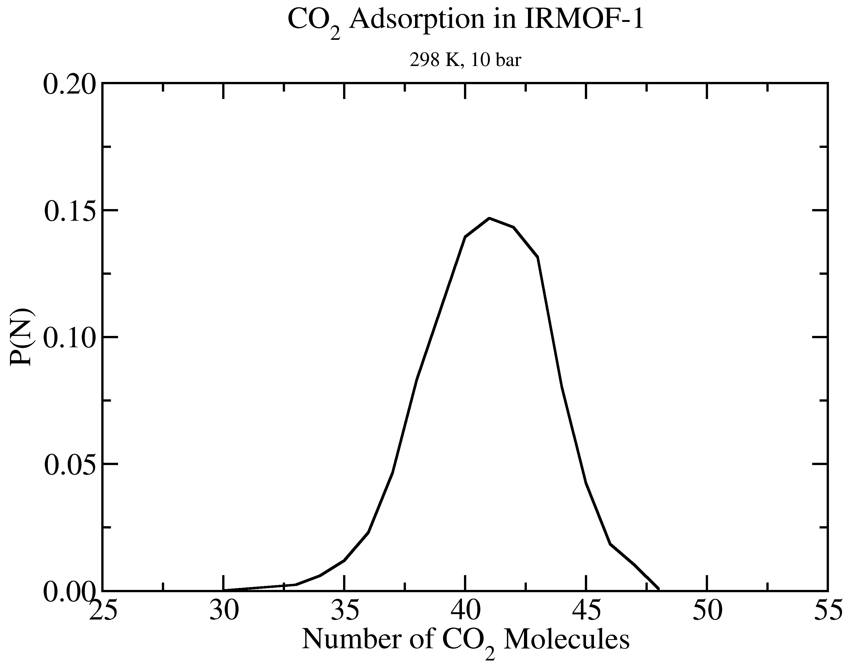
GOMC I/O: GCMC
Extract data using awk
cat output_CO2.log | awk '/STAT_0/ {print $2, $3*$5}' > mol_CO2_fluct.dat

Slide 29
Free Energy Calculation

Slide 30
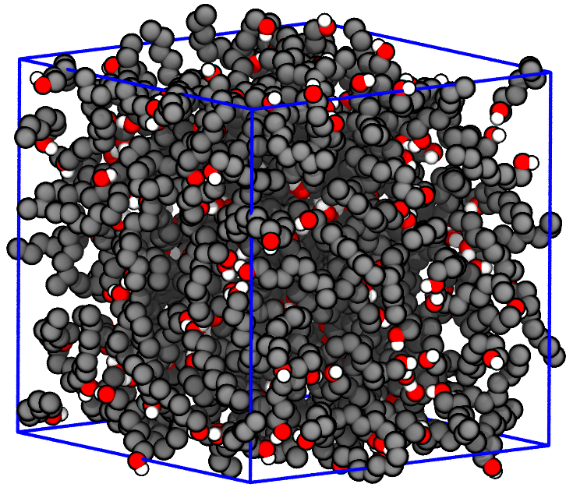
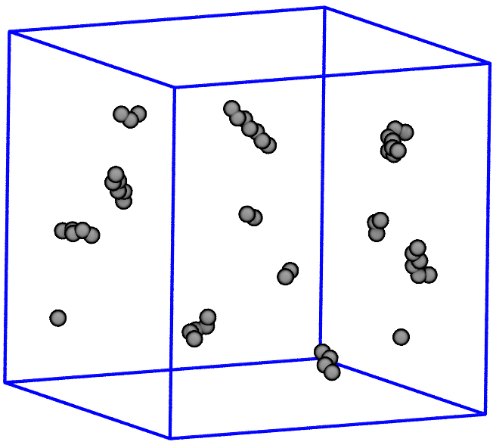
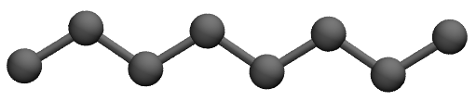
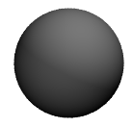
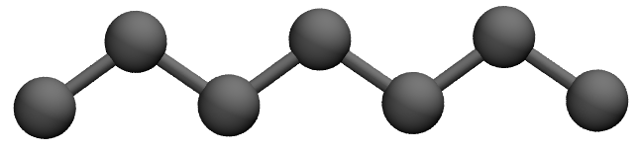
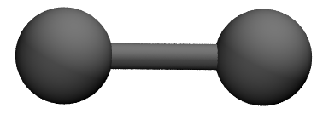
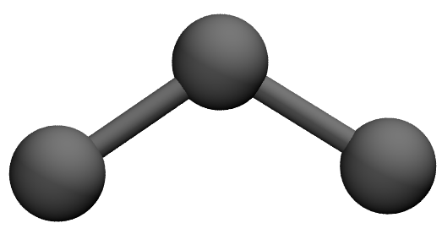
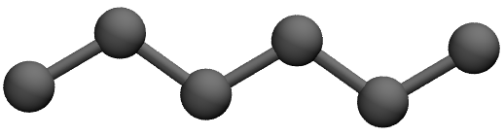
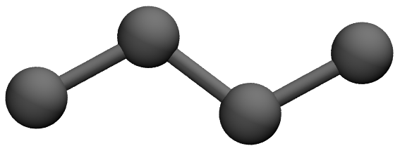
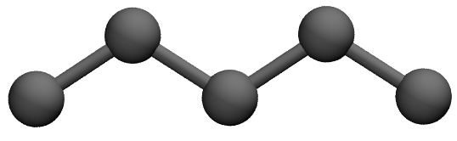
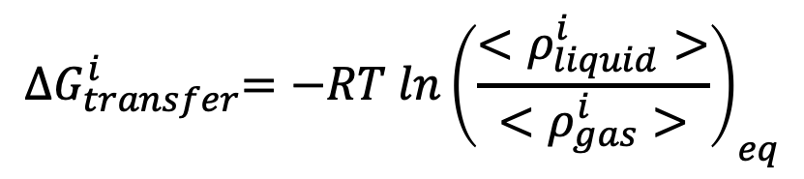
Free energy calculation: NPT-GEMC
$${∆G}_{transfer}^{i}={−RT ln\left(\frac{<ρ_{liquid}^{i}>}{<ρ_{gas}^{i}>}\right)}_{eq}$$
Notes:
Intel Xeon E5-4627v4 2.6 GhZ CPU

Slide 31
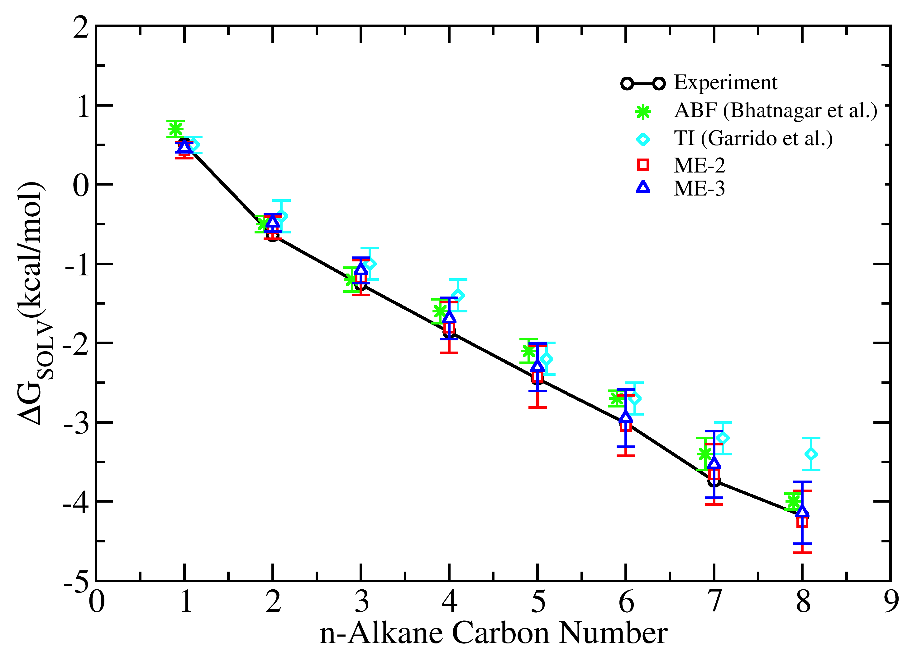
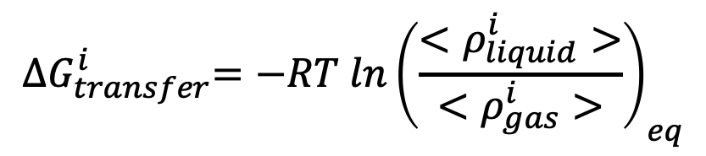
Free energy calculation: NPT-GEMC
$${∆G}_{transfer}^{i}={−RT ln\left(\frac{<ρ_{liquid}^{i}>}{<ρ_{gas}^{i}>}\right)}_{eq}$$
Figure: Free energy of solvation for n-alkanes in liquid 1-octanol predicted from NPT-GEMC simulations at 298 K and 1 atm using the TraPPE forcefield.
Notes:
Intel Xeon E5-4627v4 2.6 GhZ CPU

Slide 32
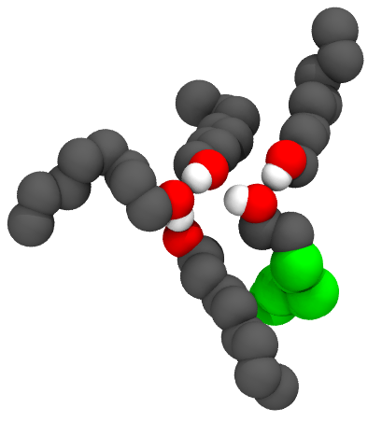
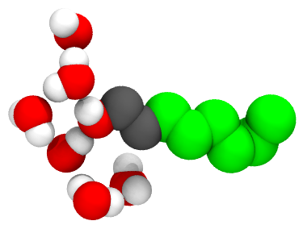
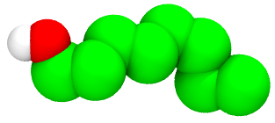

Free energy calculation Limitation: NPT-GEMC
$${∆G}_{transfer}^{i}={−RT ln\left(\frac{<ρ_{liquid}^{i}>}{<ρ_{gas}^{i}>}\right)}_{eq}$$
1-octanol
water

Slide 33






Free energy calculation: FEP
$$∆G\left(A⟶B\right)=−\frac{1}{β}\ln{{〈\exp\left(−β\left(U_{B}−U_{A}\right)\right)〉}_{A}}$$
$A$ = No interaction
$B$ = Full interaction

Slide 34













Free energy calculation: FEP/TI
$$∆G\left(A⟶B\right)=−\frac{1}{β}\sum_{i=0}^{N−1}{\ln{{〈\exp\left(−β\left(U_{i+1}−U_{i}\right)\right)〉}_{i}}}$$
$$∆G\left(A⟶B\right)=\int_{λ=0}^{λ=1}{{〈\frac{dU}{dλ}〉}_{λ}dλ}$$
$$A\left(λ_{0}=0\right)$$
$$<$$
$$λ_{1}$$
$$< . . . . <$$
$$λ_{N−1}$$
$$<$$
$$B\left(λ_{N}=1\right)$$

Slide 35


Free energy calculation: Scale nonbonded Interaction
$$U_{λ}\left(r_{ij}\right)=λ_{LJ}U_{LJ}\left(r_{sc−ij}\right)+λ_{Coul}U_{Coul}\left(r_{ij}\right)$$
$$r_{sc−ij}={\left(α{\left(1−λ_{LJ}\right)}^{p}{σ_{ij}}^{6}+{r_{ij}}^{6}\right)}^{1/6}$$
Figure: T. Steinbrecher, I. Joung, and D. A. Case, J. Comput. Chem. 32 (15), 3253 (2011).

Slide 36







Free energy calculation: FEP/TI
$$U_{LJ}\left(r_{ij}\right)=4 ε_{ij}\left[{\left(\frac{σ_{ij}}{r_{ij}}\right)}^{12}−{\left(\frac{σ_{ij}}{r_{ij}}\right)}^{6}\right]$$
$$U_{Coul}\left(r_{ij}\right)=\frac{q_{i}q_{j}}{4πε_{o}r_{ij}}$$
$$r_{sc−ij}={\left(α{\left(1−λ_{LJ}\right)}^{p}{σ_{ij}}^{6}+{r_{ij}}^{6}\right)}^{1/6}$$
$$U_{λ}\left(r_{ij}\right)=λ_{LJ}U_{LJ}\left(r_{sc−ij}\right)+λ_{Coul}U_{Coul}\left(r_{ij}\right)$$
$$\frac{dU_{λ}\left(r_{ij}\right)}{dλ_{LJ}}=U_{LJ}\left(r_{sc−ij}\right)+\frac{λ_{LJ}pα}{6}{\left(1−λ_{LJ}\right)}^{p−1}\left(\frac{{σ_{ij}}^{6}}{{r_{ij}}^{5}}\right)F_{LJ}\left(r_{sc−ij}\right)$$
$$\frac{{dU}_{Coul}\left(r_{ij}\right)}{dλ_{Coul}}=U_{Coul}\left(r_{ij}\right)$$
$$F_{LJ}\left(r_{ij}\right)=−\frac{{dU}_{LJ}\left(r_{ij}\right)}{dr_{ij}}=\frac{4ε_{ij}}{r_{ij}}\left[12{\left(\frac{σ_{ij}}{r_{ij}}\right)}^{12}−{6\left(\frac{σ_{ij}}{r_{ij}}\right)}^{6}\right]$$

Slide 37
Free energy calculation: FEP/TI
Solvation free energy of Ne in cyclohexane at 298 K and 1.0 bar
NVT simulation in 4 intermediate states
Calculate Ne solvation free energy in cyclohexane with alchemlyb
Calculate Ne solvation free energy in cyclohexane with alchemical-analysis
Solvation free energy of Ar in cyclohexane at 298 K and 1.0 bar
NVT simulation in 4 intermediate states
Calculate Ar solvation free energy in cyclohexane with alchemlyb
Calculate Ar solvation free energy in cyclohexane with alchemical-analysis
Solvation free energy of Kr in cyclohexane at 298 K and 1.0 bar
NVT simulation in 4 intermediate states
Calculate Kr solvation free energy in cyclohexane with alchemlyb
Calculate Kr solvation free energy in cyclohexane with alchemical-analysis

Slide 38




Free energy calculation: Simulation Process
Pack solvent + 1 solute
alchemlyb,
alchemical-analysis
NVT at 298 K
NVT at 298 K,
$$λ_{i}$$
NPT at 298 K,
1.0 bar
NPT at 298 K,
1.0 bar, $λ_{i}$
https://github.com/msoroush/alchemical-analysis
https://github.com/alchemistry/alchemlyb
Notes:
Green box means, we already performed the simulation
Red box means, they should do it in the workshop

Slide 39


Control file: Free Energy calculation
Restart true
Coordinates 0 ./EQ_BOX_0_restart.pdb
Structure 0 ./EQ_merged.psf
# FREE ENERGY PARAMETER
FreeEnergyCalc true 1000
MoleculeType NE 1
InitialState 1
ScalePower 2
ScaleAlpha 0.5
MinSigma 3.0
ScaleCoulomb false
LambdaVDW 0.00 0.20 0.40 0.60 0.8 1.00 1.00 1.00 1.00 1.00 1.00
LambdaCoulomb 0.00 0.00 0.00 0.00 0.00 0.00 0.20 0.40 0.60 0.80 1.00
$$r_{sc−ij}={\left(α{\left(1−λ_{LJ}\right)}^{p}{σ_{ij}}^{6}+{r_{ij}}^{6}\right)}^{1/6}$$

Slide 40

GOMC Free Energy Output
Table: Sample of GOMC free energy data
$T=298$ (K) |  | $$λ_{2}=(0.0, 0.2)$$
Steps | $$U_{total}$$ | $$\frac{dU_{coul}}{dλ_{2, coul}}$$ | $$\frac{dU_{LJ}}{dλ_{2, LJ}}$$ | $${∆U}_{2→0}$$ | $${∆U}_{2→1}$$ | $${∆U}_{2→2}$$ | … | $${∆U}_{2→15}$$ | $$PV$$
1000 | -8877.456 | -3.231 | 8.077 | 10.004 | 2.624 | 0.000 | … | 2266.677 | 3.181
2000 | -8835.898 | 2.683 | 110.732 | -0.256 | -4.425 | 0.000 | … | 47079.538 | 3.164
3000 | -8827.969 | 1.666 | 245.945 | -14.514 | -14.142 | 0.000 | … | 19780.139 | 3.188
… | … | … | … | … | … | … | … | … | …
10000 | -8819.957 | -11.471 | 37.901 | 6.680 | 0.422 | 0.000 | … | 1383.572 | 3.171
Notes:
F2H6 in hexadecane

Slide 41
Ne Solvation Free Energy: 4 States

Slide 42
Ne Solvation Free Energy: 10 States

Slide 43
Ar Solvation Free Energy: 4 States

Slide 44
Ar Solvation Free Energy: 10 States

Slide 45
Kr Solvation Free Energy: 4 States

Slide 46
Kr Solvation Free Energy: 10 States

Slide 47

GOMC on Multicore and GPU

Slide 48
Acknowledgements
Jason Mick, Younes Nejahi, Kamel Rushaidat, Niloofar Torabi, Brock Jackman, Navendu Bhatnagar, Ganesh Kamath, Loren Schwiebert
National Science Foundation CBET-1066661, ACI-1148168, OAC-1642406
NVIDIA, Silicon Mechanics
Grid Computing at WSU

